Slide 1
What Department Chairs Need to Know About Social Media
Dr. Stephanie Vie
University of Central Florida
Institute for Academic Leadership
Department Chairs Workshop
Spring 2018

Slide 2
Overview
My background
Definitions and history
Demographics
Why use social media?
How to use social media
Common concerns
Questions and answers

Slide 3
My background
Expertise in social media research, teaching, and use for over twenty years

Slide 4
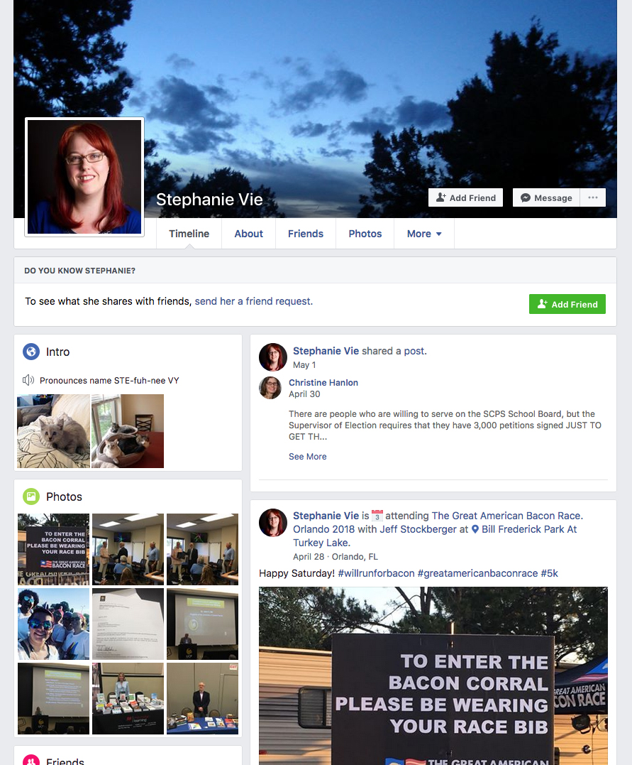
Facebook:
Active since March 2006
717 connections (friends)
Audience:
Mix of academic connections, offline acquaintances and friends, and family
Content:
Mix of personal and professional
Mainly academic and personal accomplishments

Slide 5
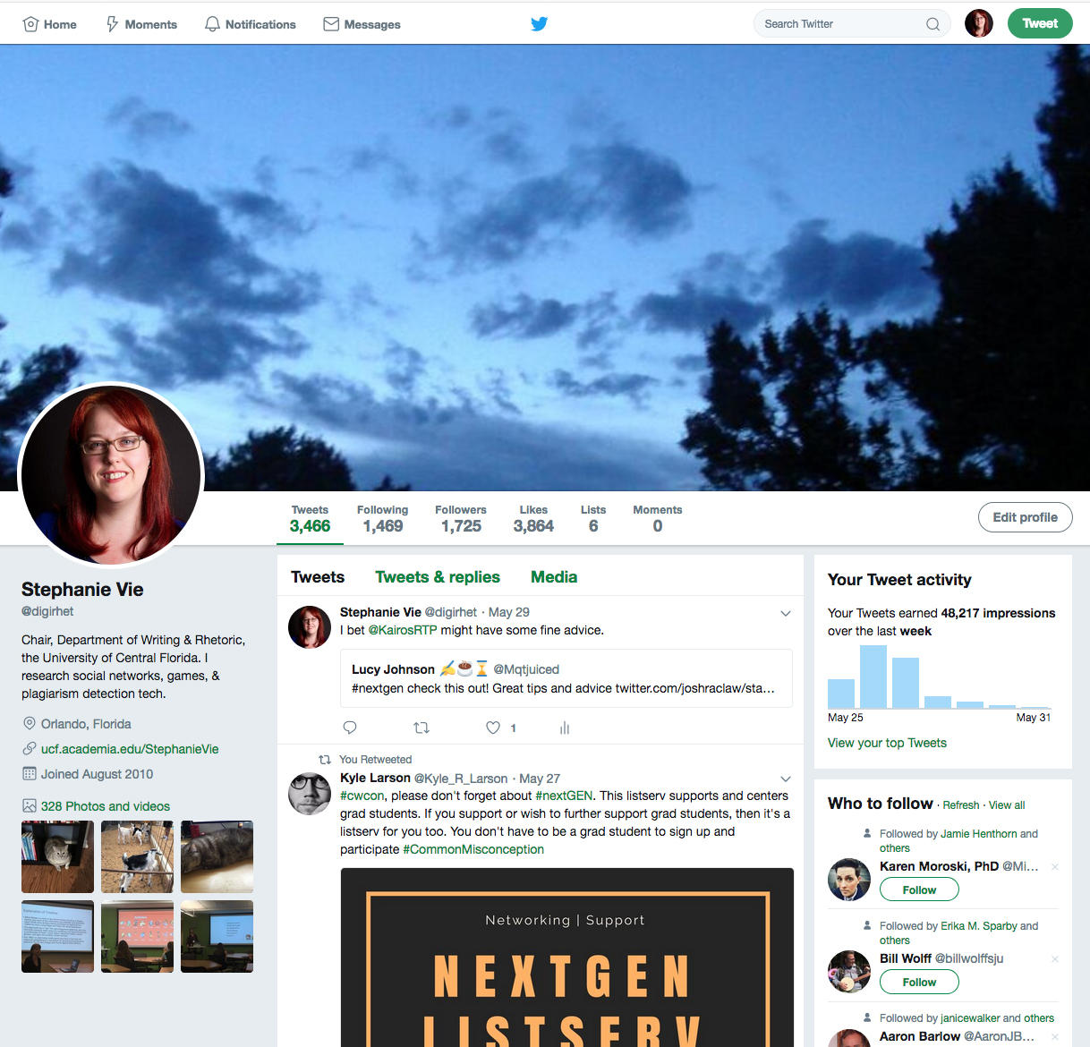
Twitter:
Active since August 2010
1,725 connections (followers)
Audience:
Almost all academic connections
Content:
Mix of personal and professional
Heavily networking using @ and # features

Slide 6
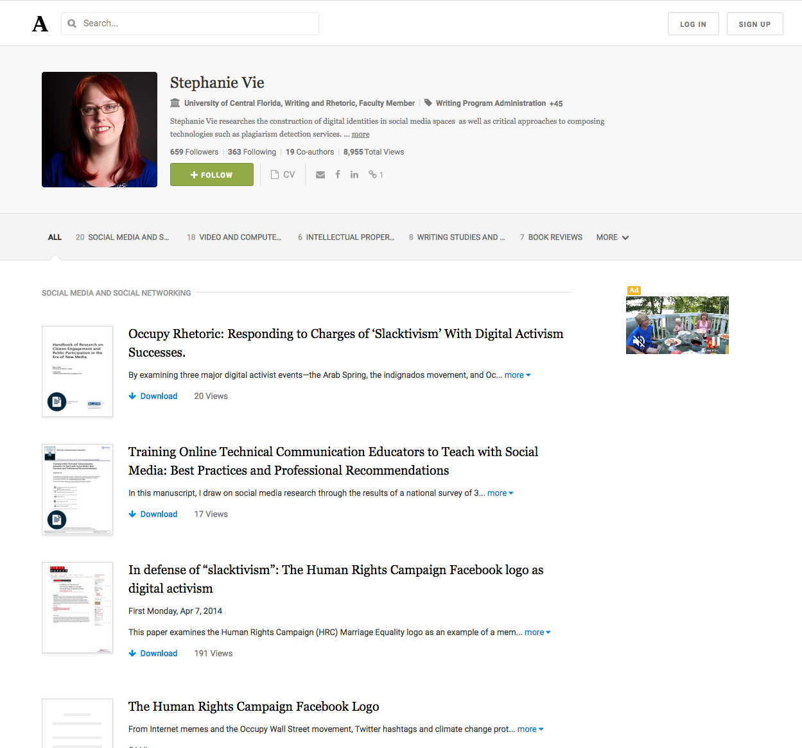
Academia.edu:
Active since April 2013
659 connections (followers)
Audience:
All academic connections
Content:
All scholarly
Offers downloadable content for viewers

Slide 7
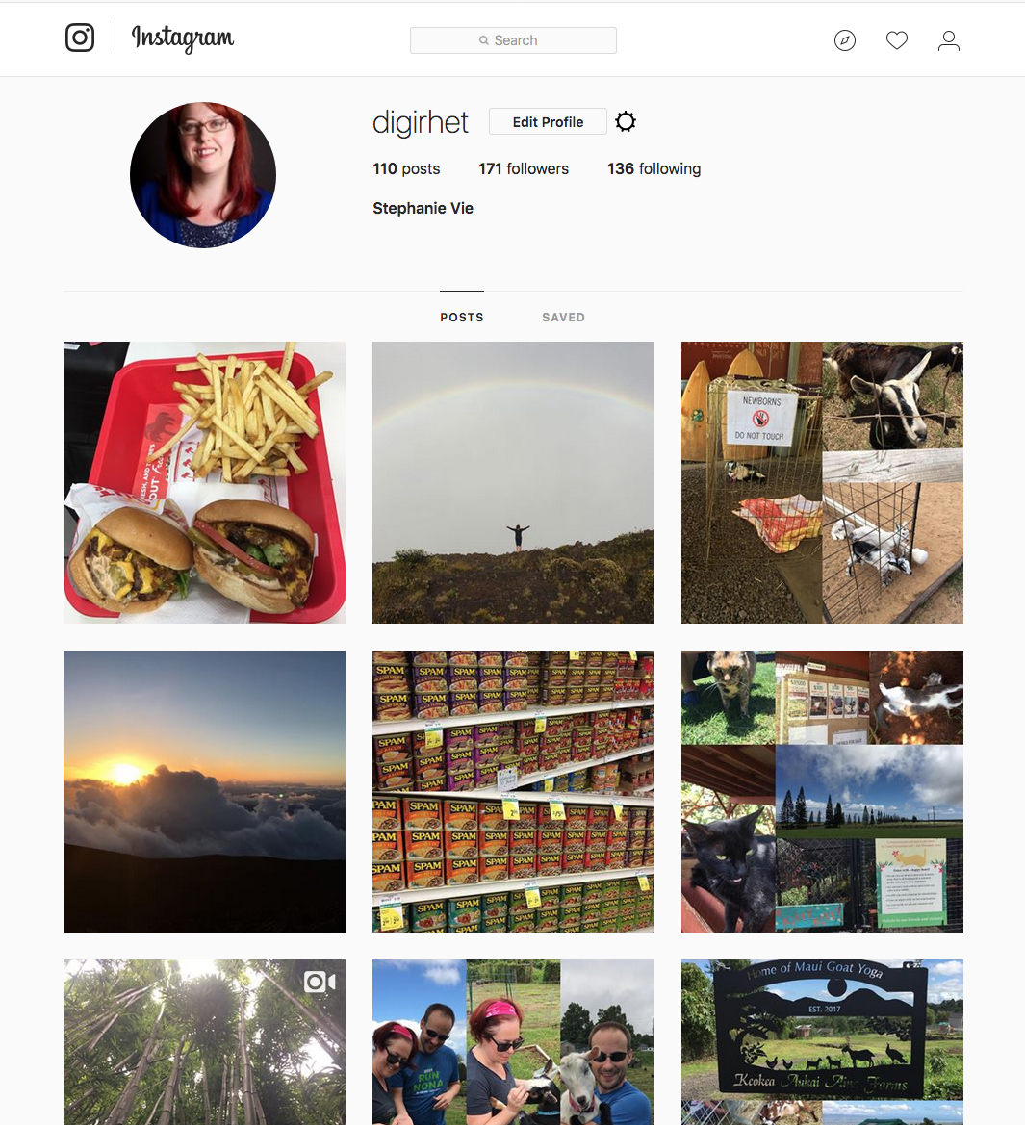
Instagram:
Active since December 2016
171 connections (followers)
Audience:
Mostly personal connections with some academic
Content:
Almost all personal, not scholarly
Images and videos about travel and food

Slide 8
Definitions and history
Social media and social networking

Slide 9
Definitions
Social Media
Social Networking
“No commonly accepted definition of social media” (Carr & Hayes, 2015)
“SNS [feature] … (1) a public or semi‐public profile within a bounded system, (2) … a list of other users with whom they share a connection, and (3) [ability to] view and traverse their list of connections and … others within the system” (boyd & Ellison, 2007)

Slide 10
History
McGuire, S. (2018). Venngage. https://bit.ly/2kC25mt

Slide 11
History
Squires, D. (2016). Everything you ever wanted to know about social media. https://bit.ly/2H8gL5F

Slide 12
Demographics
Who’s using social media and which ones?

Slide 13
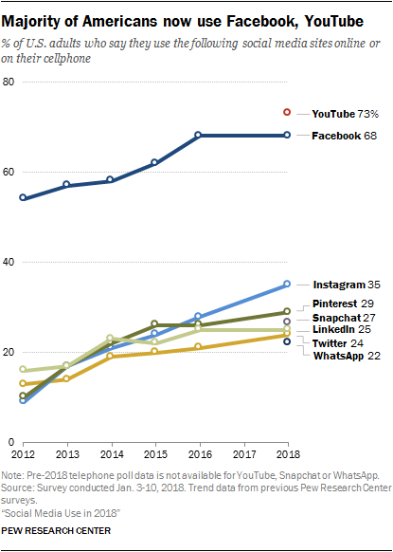
Demographics
~ 68% of U.S. adults use Facebook in 2018
Up from ~ 54% in 2012
Other than YouTube, no other social media comes close for adults
The median American adult uses 3 of the 8 social media listed here

Slide 14
Demographics
Teens use Instagram and Snapchat more than Facebook or Twitter
Only 10% of teens say Facebook is their most used platform
78% of 18- to 24-year-olds are Snapchat users

Slide 15
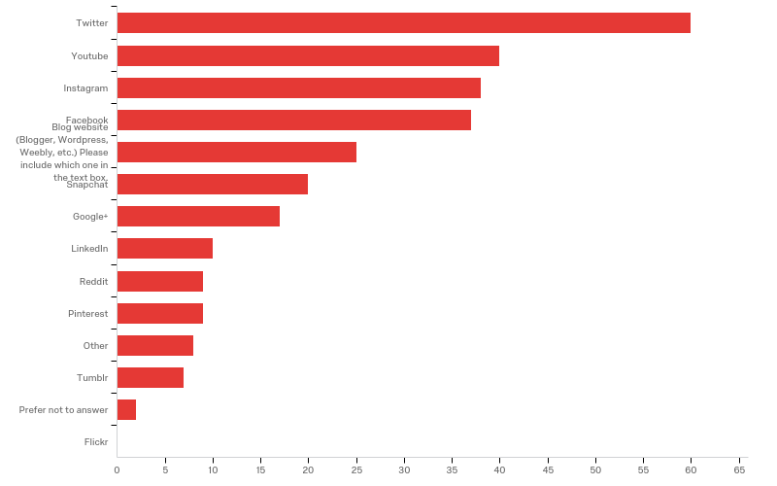
Demographics
Which social media platforms did you use in your writing classroom? (n = 98)

Slide 16
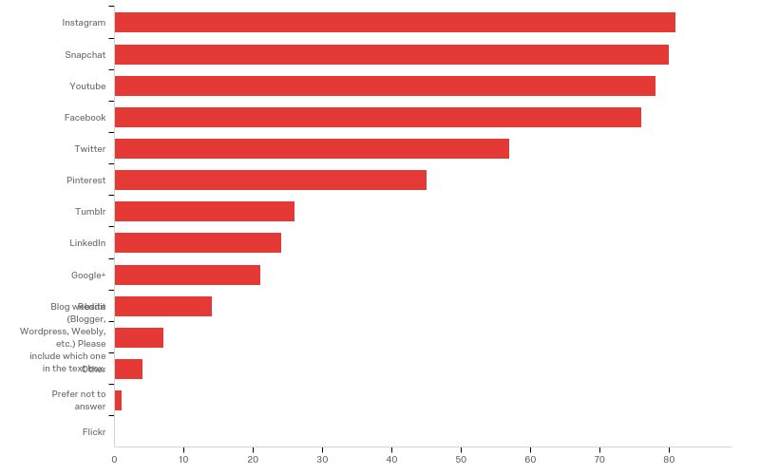
Demographics
Which social media did you use outside of the writing classroom? (n = 98)

Slide 17
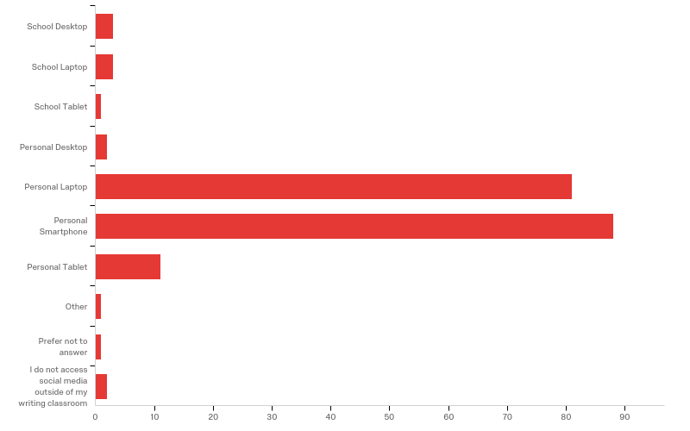
Demographics
How do you access social media outside of the writing classroom? (n = 98)

Slide 18
Why use social media?
Benefits from a department chair’s perspective

Slide 19
Why Use Social Media?
Increasing student retention
Increasing faculty retention
Shoring up student recruitment
Harnessing 21st-century literacies
Increasing networking opportunities

Slide 20
Student Recruitment
Allows your department to reach students where they get their information: online
Develops networks that help you advertise your department and programs
Adds value to traditional channels for marketing and recruitment

Slide 21
Ellucian/Chronicle of Higher Education, 2017

Slide 22
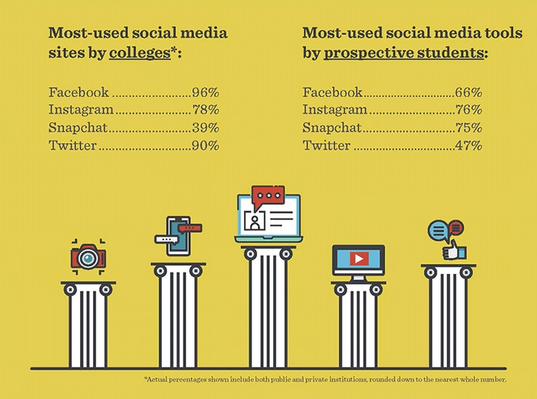
Ellucian/Chronicle of Higher Education, 2017

Slide 23
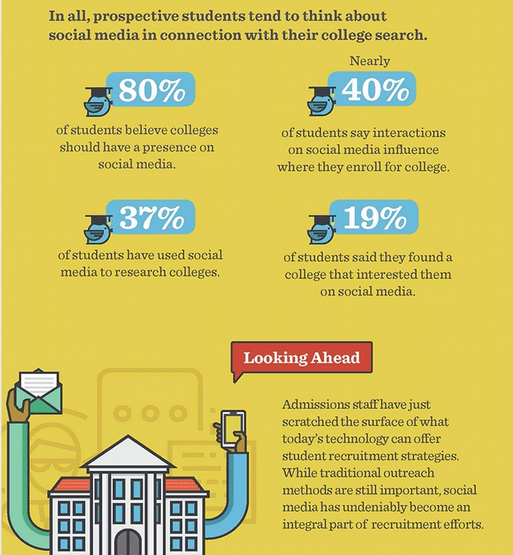
Ellucian/Chronicle of Higher Education, 2017

Slide 24
Student Retention
Students expect a technologically rich university experience
Social media can increase a sense of belonging and community
Social media can be used to share students’ good news and accolades
Students use social media to ask questions and provide feedback
Underrepresented students turn to social media for college information at higher rates than non-minority students

Slide 25
Faculty Retention
Offers increased engagement with faculty members
Allows for specialized support groups
Provides a way to increase recognition of faculty efforts
Offers a means for increased visibility of faculty research, which can lead to increased citation metrics

Slide 26
Harnessing 21st-century Literacies
Allows students opportunities to craft messages for varied audiences
Offers collaborative communication channels for students
Exposes students to communication technologies they will use post-graduation in the workplace
Provides access to global conversations and perspectives
Offers examples for grounding discussions of digital citizenship and critical literacies

Slide 27
Networking
Provides spaces for developing strong and weak ties (Granovetter)
Offers connections to professional networks for post-graduate needs
Allows students, particularly those at risk of attrition, opportunities to develop networks of support
Taps students and faculty into professional resources and networks

Slide 28
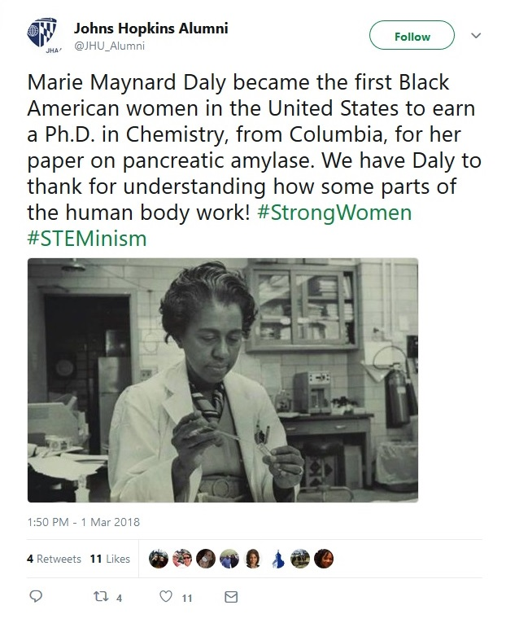
STEM communities have used targeted hashtag campaigns to fight the continued problem of underrepresentation of women and minorities in science

Slide 29
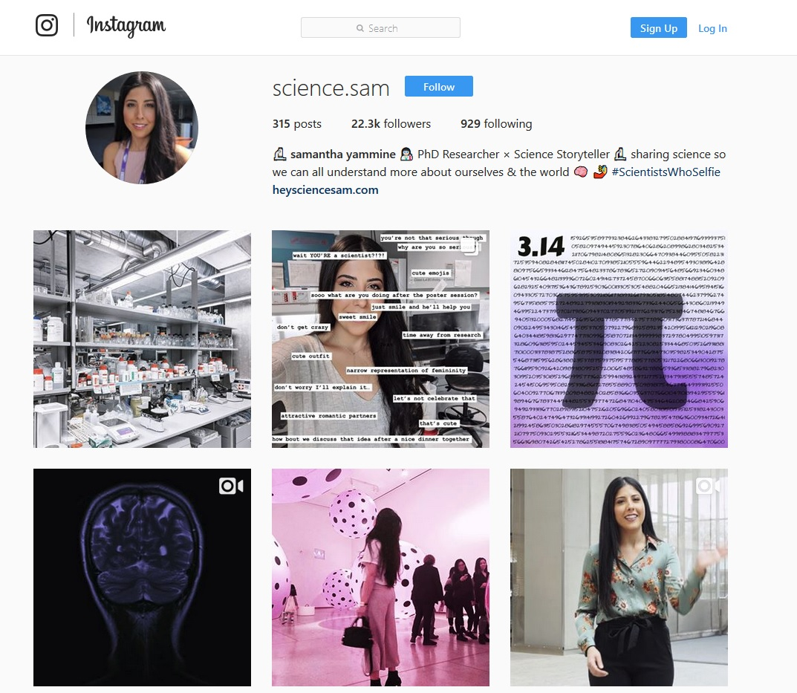
Female scientists use social media like Instagram to highlight women in STEM

Slide 30
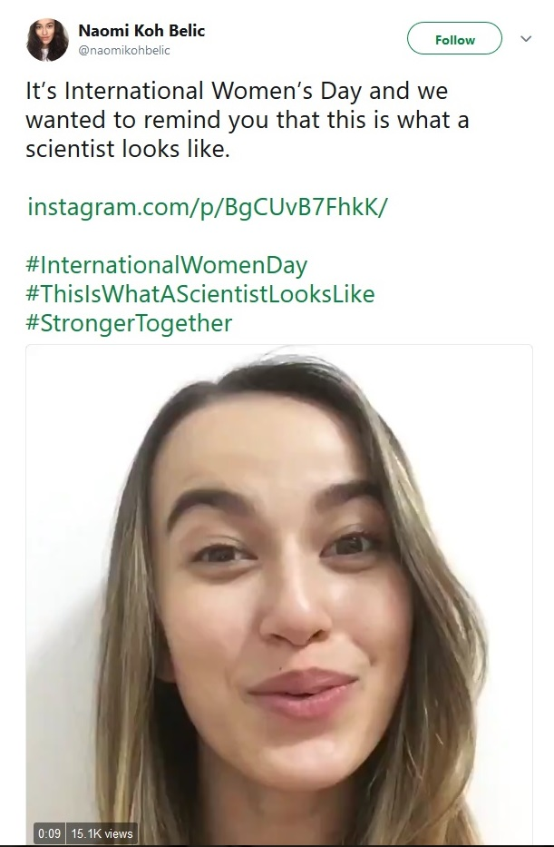
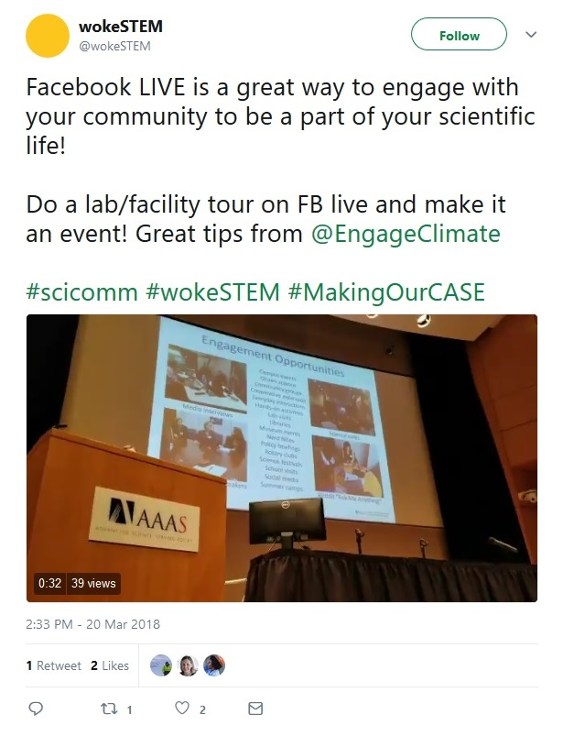

Slide 31
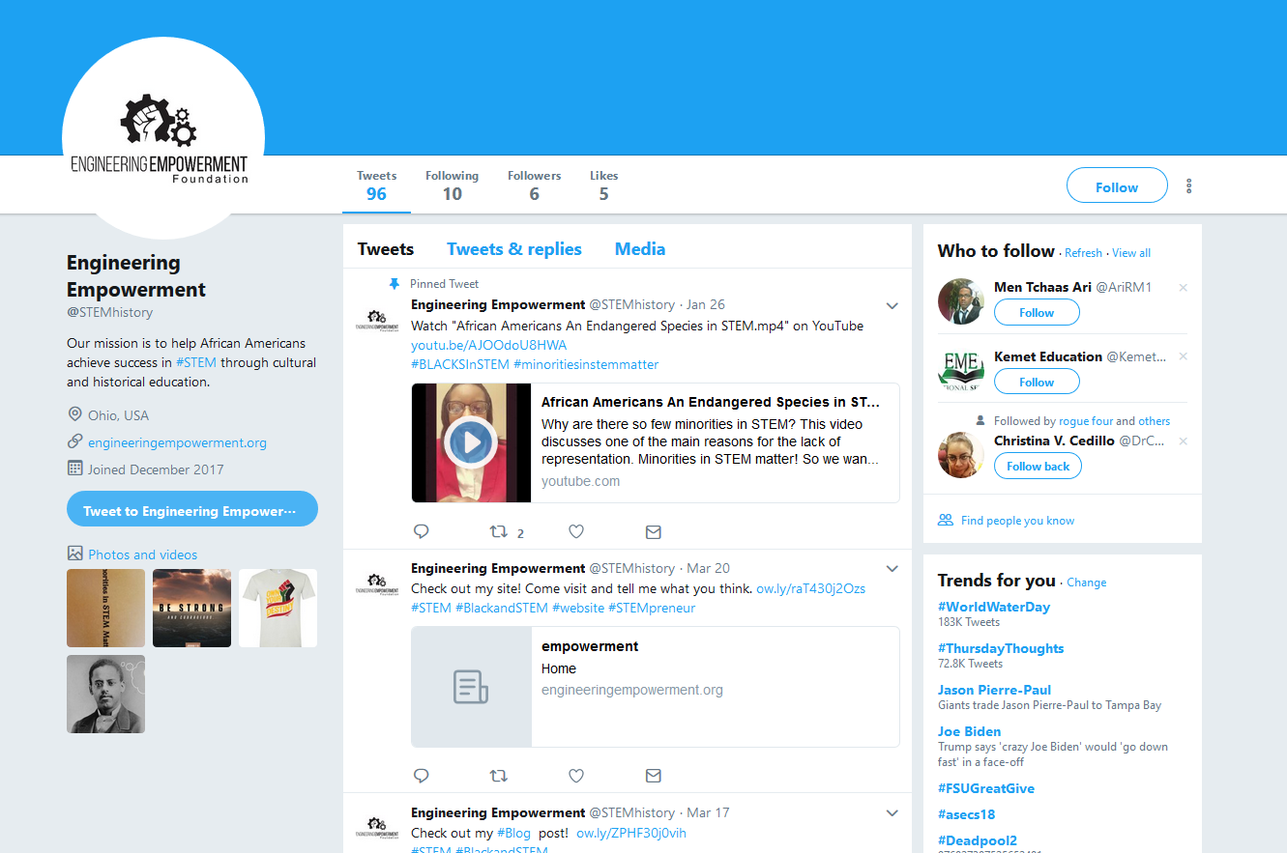

Slide 32
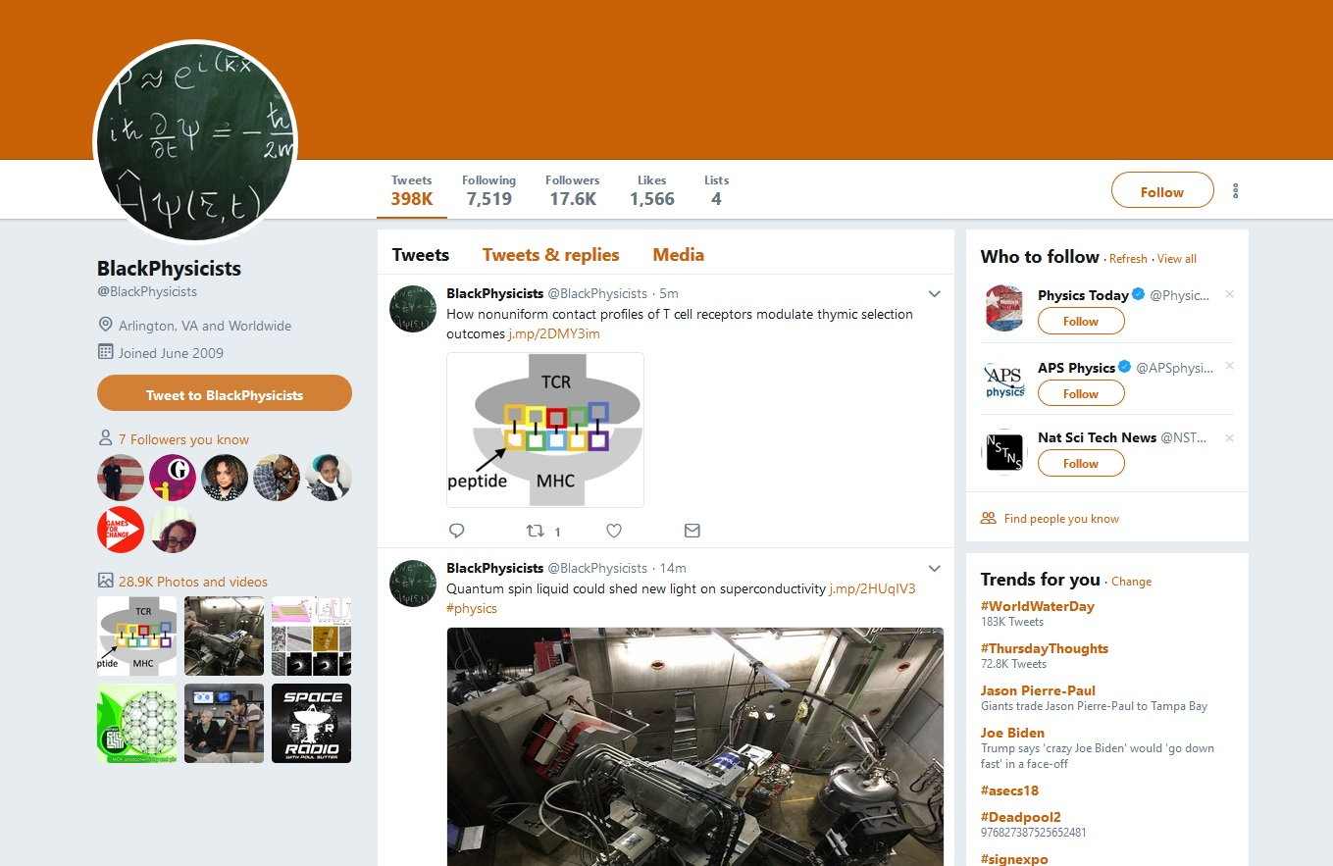

Slide 33
How to use social media
Thinking rhetorically as a department chair

Slide 34
How to Use Social Media
Create a social media plan and goals
Think rhetorically:
What is my goal?
Who is my intended audience (audiences)?
What content will we develop?
How can I address reach and spread?
Who will manage the plan and the accounts?

Slide 35
How to Use Social Media
Think branding:
What is your department’s message, mission, vision?
What is your takeaway as a scholar, teacher, administrator?
Do these messages overlap?
You must be intentional and maintain/groom your social media presence!

Slide 36
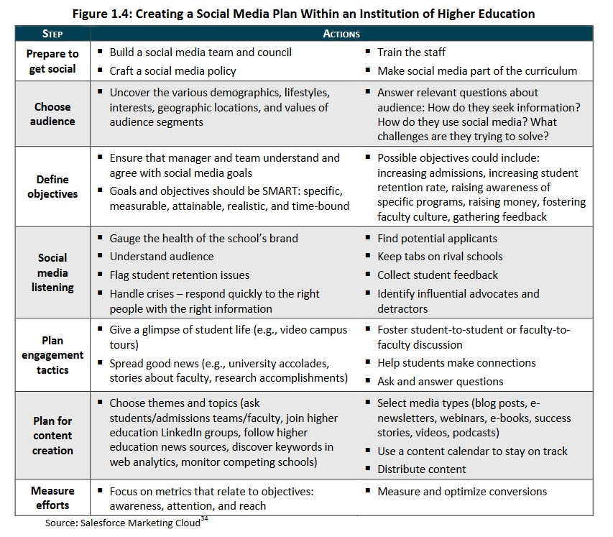

Slide 37
Common concerns
“Here’s what I’m worried about when thinking about social media…”

Slide 38
Time
Privacy
Free
Speech
Trolling

Slide 39
Thank you! Questions?
Dr. Stephanie Vie
@digirhet on Twitter

